Slide 1
M V C
Model-View-Controller

Slide 2
The Model-View-Controller (MVC) architectural pattern separates an application into three main components: the model, the view, and the controller
MVC is one of the most frequently used industry-standard web development framework to create scalable and extensible projects.

Slide 3
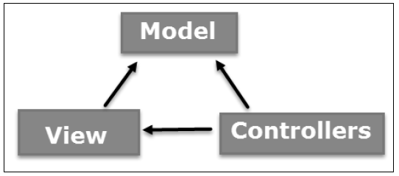
MVC Components

Slide 4
Models
The Model component corresponds to all the data-related logic that the user works with. This can represent either the data that is being transferred between the View and Controller components or any other business logic-related data.
For example, a Customer object will retrieve the customer information from the database, manipulate it and update it data back to the database or use it to render data.

Slide 5
View
The View component is used for all the UI logic of the application. For example, the Customer view will include all the UI components such as text boxes, dropdowns, etc.

Slide 6
Controllers.
Input logic belongs in the controller.
Controllers act as an interface between Model and View components to process all the business logic and incoming requests
For example, the controller handles query-string values, and passes these values to the model, which in turn might use these values to query the database.

Slide 7
Advantages of an MVC-Web Application
It makes it easier to manage complexity by dividing an application into the model, the view, and the controller.
It does not use view state or server-based forms. This makes the MVC framework ideal for developers who want full control over the behavior of an application.
It works well for Web applications that are supported by large teams of developers.

Slide 8
Features of the MVC Framework
Separation of application tasks (input logic, business logic, and UI logic).
You can use any unit-testing framework that is compatible with the .NET Framework.
An extensible and pluggable framework.
You can plug in your own view engine, URL routing policy, action-method.

Slide 9
Powerful URL-mapping component that lets you build applications that have comprehensible and searchable URLs.
URLs do not have to include file-name extensions
You can use existing ASP.NET features with the ASP.NET MVC framework,

Slide 10
Entity Framework
The Microsoft ADO.NET Entity Framework is an Object/Relational Mapping (ORM)
It enables developers to work with relational data as domain-specific objects
Using the Entity Framework, developers issue queries using LINQ, then retrieve and manipulate data as strongly typed objects.
The Entity Framework's ORM implementation provides services like change tracking, identity resolution, lazy loading, and query translation so that developers can focus on their application-specific business logic rather than the data access fundamentals.
Or simply: Entity framework is an Object/Relational Mapping (O/RM) framework. It is an enhancement to ADO.NET that gives developers an automated mechanism for accessing & storing the data in the database, and for working with the results, in addition to Datareader and Dataset.

Slide 11
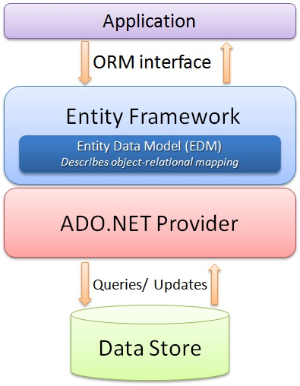
Entity Framework

